Slide 1
Tariffs and Trade
Merton D. Finkler, Ph.D.
Discussion with Golden K Kiwanis Club
Good Shepherd Lutheran Church
September 12, 2018

Slide 2
Topics to Be Addressed
Tariffs – a definition and history
The composition of imported goods and services
The relationship between imports and exports
Trade deficits (current account) must be matched by capital inflows (capital account). Causality can be either direction.
Tariff related legislation
Two examples of the effects of Trumpian tariffs
Many pleas for exemptions from tariffs lead to “crony capitalism

Slide 3
Tariffs defined
In his 1906 Devil’s Dictionary, Ambrose Bierce’s defined tariffs as “A scale of taxes on imports, designed to protect domestic producers from consumers.”
First part: an excise tax on a subset of products and services provided by sellers outside the domestic economy.
Second part: designed to protect domestic producer is an intention not a result.
Comment: the effects depend upon supply and demand for the product being taxed.

Slide 4
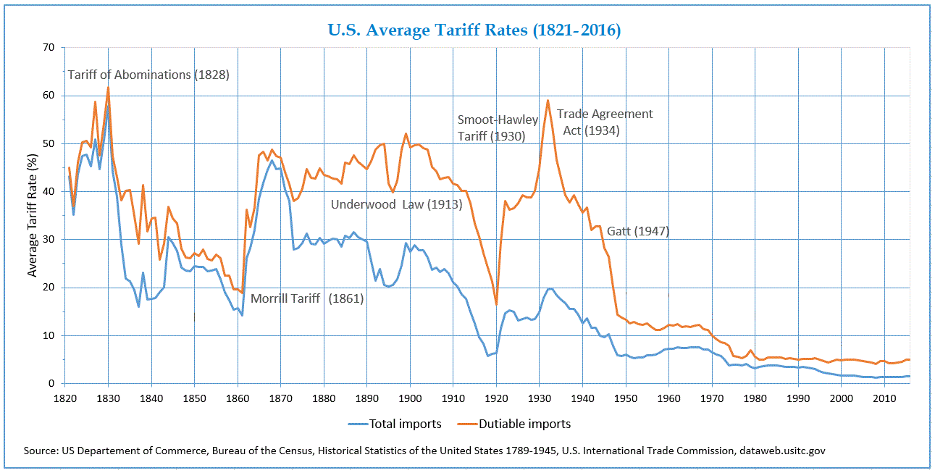
Hamilton wanted tariffs to protect US manufacturing. Tariff Act of 1789 – first major act of Congress
In the 19th century, tariffs made up as much as a third of Federal government revenue
On the eve of WWI, tariffs made up 20% of revenue.
Presently, tariffs account for roughly $26 billion per year or .05% of governmental revenues

Slide 5
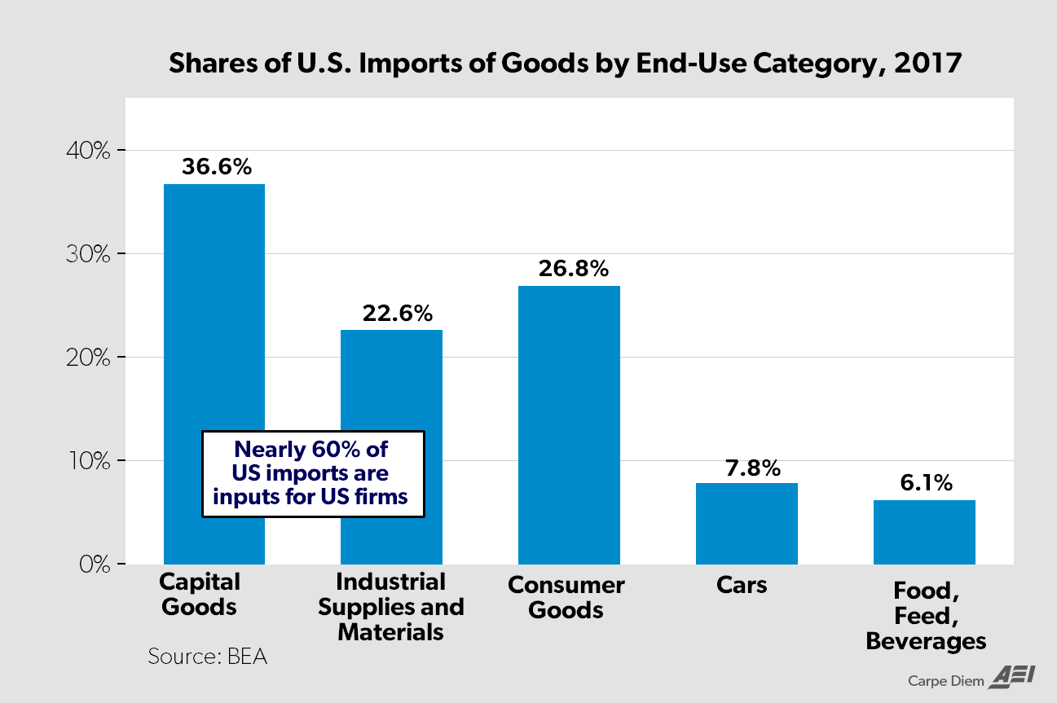

Slide 6
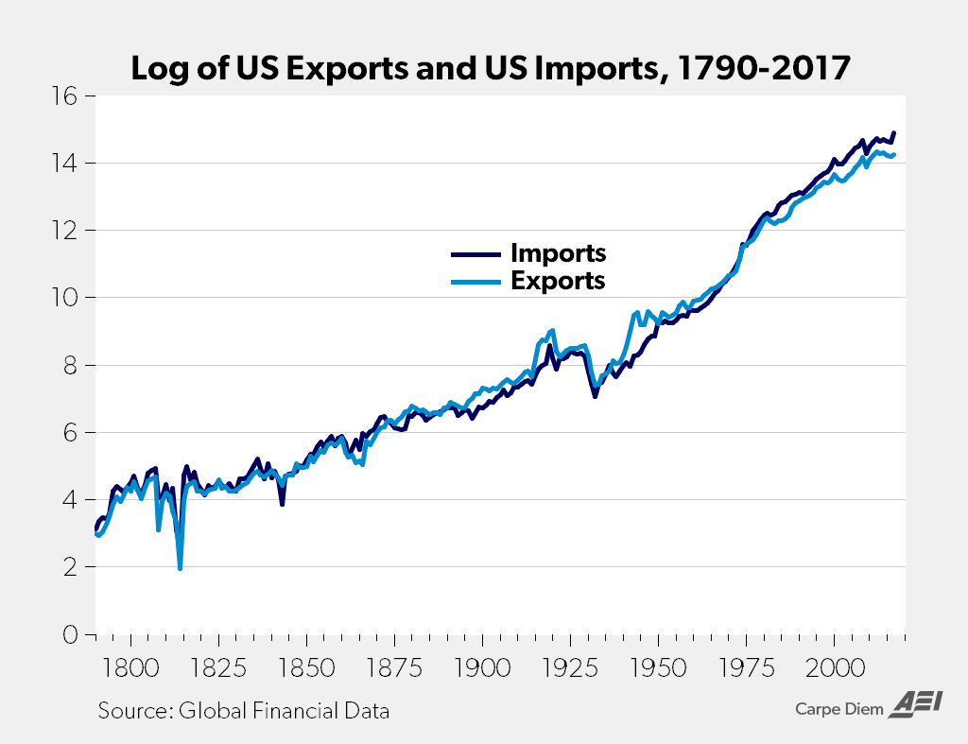

Slide 7
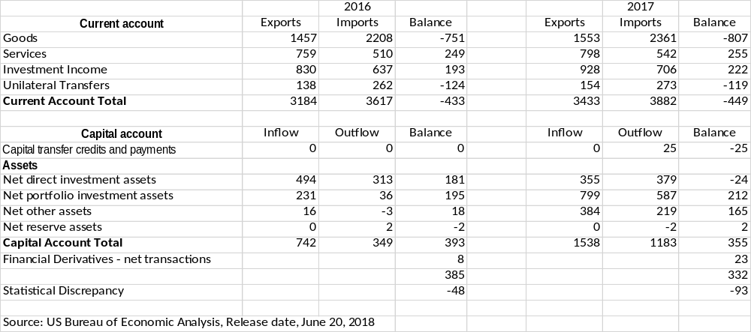
Current and Capital Account Transactions
($ Billions)

Slide 8
Tariff – Related Legislation
Section 232 of Trade Expansion Act of 1962
  authorizes the President of the United States, through tariffs or other means, to adjust the imports of goods or materials from other countries if it deems the quantity or circumstances surrounding those imports to threaten national security.
Section 301 of Trade Act of 1974
  authorizes the President to take all appropriate action, including retaliation, to obtain the removal of any act, policy, or practice of a foreign government that violates an international trade agreement or is unjustified, unreasonable, or discriminatory, and that burdens or restricts U.S. commerce.
Trump tariff time line https://piie.com/system/files/documents/trump-trade-war-timeline.pdf

Slide 9
Agriculture Loses From Tariff War
Cherries
  In response to US tariffs on steel and aluminum, China imposed a 25% tariff on cherries, which they raised to 50% on July 6th
  Cherries are a luxury item for the affluent Chinese
  Since cherries are perishable and the crop was already set to harvest and pack, China provided 2 options: buy nothing or sellers absorb the entire tariff.
  Since cherries are not easily storable (though some could be frozen), Pacific Northwest cherry exporters had to absorb the losses.
  Similar patterns for pears and apples
  Similar counter tariffs for Mexico and India
Result: farmers are forced to “dump” their products in markets at prices below the cost of production.

Slide 10
The Harley-Davidson Case
American and European consumers are taxed as a result of the US and European tariffs
  American producers, including Harley Davidson and its suppliers, are taxed as consumers of aluminum and steel (on which tariffs of 10% and 25% apply respectively.)
  European consumers of Harley products are taxed by the European Union, where the tariff rate increased from 6% to 31%.
Consider the following example as representative. A 2018 Harley Davidson Street 500 sells for roughly $7,000 in the US. Assuming the steel and aluminum tariffs add 10% to the price in the US (raising the consumer price to $7,700) the 25 percentage point increase in European tariffs would further raise the price for Europeans to $9,625, an increase of 37.5%.
Changes in prices can effect exchange rates.
  The value of the euro has fallen from roughly $1.24 per euro to as low as $1.14 since April
  the price for Europeans would rise from the original $7,000 or 5,645 euros to $9,625 or 8,443 euros; so the base price would have increased by almost 50%.
  Clearly, Europeans would buy many fewer Harleys. It would make business sense for Harley to produce its motorcycles in Europe – its second largest market - to avoid both sets of taxes and exchange rate volatility. In short, both European consumers and US producers (and laborers who work for Harley or its domestic suppliers) would be losers.
The President’s intervention in the market for motorcycles could lead to consumers substituting Japanese motorcycles for Harleys or just lower motorcycle sales overall.
Clearly, the President is attempting to use his influence to intervene in private markets.
  It’s not clear who would benefit, but it is clear who the losers would be.
  It’s not even clear that any domestic producers would benefit.
  A slight increase in revenues from the tariffs would flow into government coffers in both places; however, reduced domestic sales and income would counter the flows to government treasuries.
The result is clear losers and few if any winners from policies that fly in the face of economic logic.

Slide 11
American Producers Cry For Tariff Exemptions
Over 20,000 requests for exemption from steel and aluminum tariffs by US companies
6.5 million workers will be negatively affected by tariffs
140,000 steel workers might benefit from tariffs
Commerce doesn’t have to consider the losers in making a judgment about imposing a tariff
Under Section 201 (Trade Act of 1974)US International Trade Commission is NOT ALLOWED to consider the losers (consumers) in making a judgment that a tariff is an appropriate governmental action

Slide 12
My Blog: noconecon.wordpress.com
Trade Deficits: A Poor Focus for Public Policy – August 6, 2018
Making America Mercantilist Again: 6 False Premises That Underpin US Tariff Policy – March 11, 2018
A Second Globalization Features The Great Convergence – May 2, 2017
Are U.S. Exchange Rates Too High, Too Low, or Just Right? – March 7, 2017
Myths About International Trade – February 9, 2017

Slide 13
