Slide 1


Appleton… We Have a Healthcare Problem!
The Fox Valley Health Care Transformation Initiative
Presentation by Merton Finkler, Ph.D
John R. Kimberly Emeritus Professor of Economics
October 16, 2018

Slide 2

Overview of Presentation
Describe The Fox Valley Health Care Transformation Initiative
Observation 1: Medical costs in the Fox Valley are unsustainable and unaffordable for many residents.
Observation 2: Local healthcare systems lack transparency and are unaccountable. In our opinion, unelected “elites” serve their institutions rather the community at large.
Observation 3: Local health care system and delivery reform can take place but will require local residents to actively demand serious reform.
A call for discussion and action

Slide 3

The Fox Valley Health Care
Transformation Initiative
Created in the summer of 2017.
Objective: To transform the organization, delivery, and financing of the medical systems in the Fox Valley to achieve the Triple Aim of lower cost, better health, and improved patient experience for the residents of the Fox Valley.
This presentation to the community at large is a direct result of the lack of responsiveness of our public sector leaders.
For change to occur, we need your help.
History of activities – https://www.foxvalleyhealthcare.com
Team members - https://www.foxvalleyhealthcare.com/meet-the-team

Slide 4
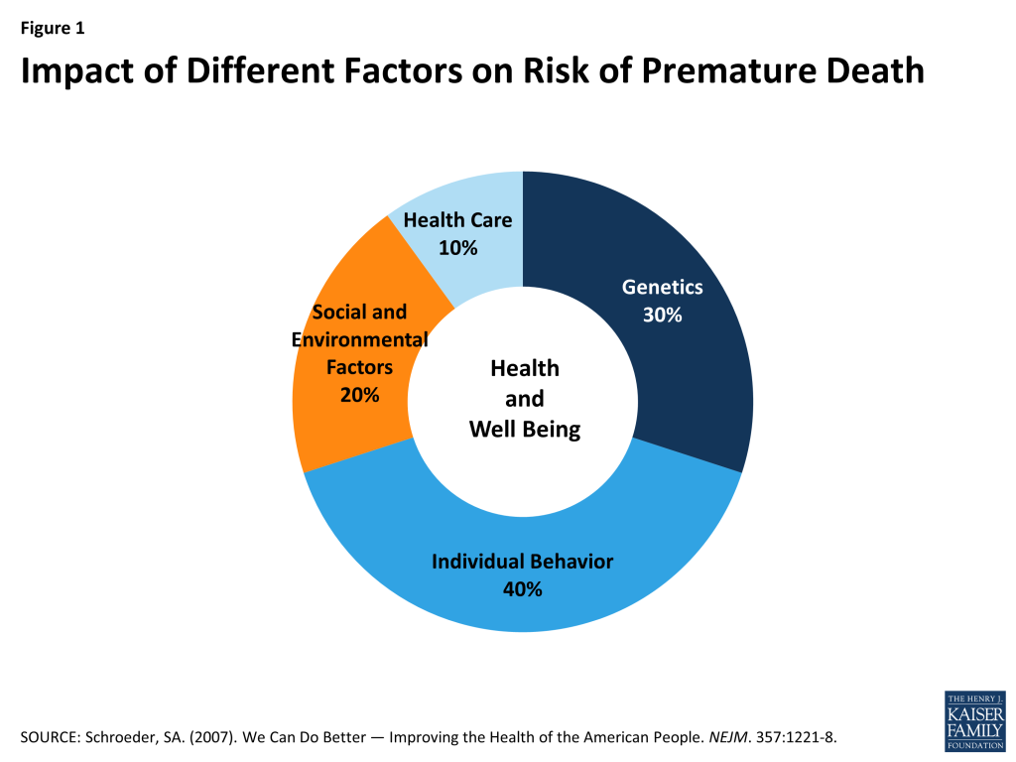
Medical Care is the least important but most expensive way to improve the health of the community

Slide 5
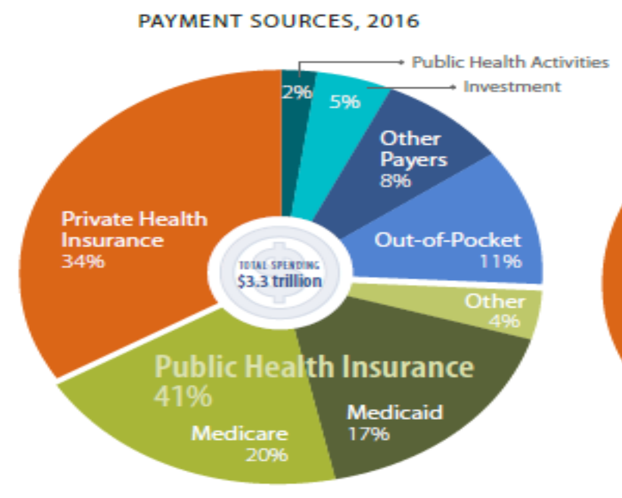
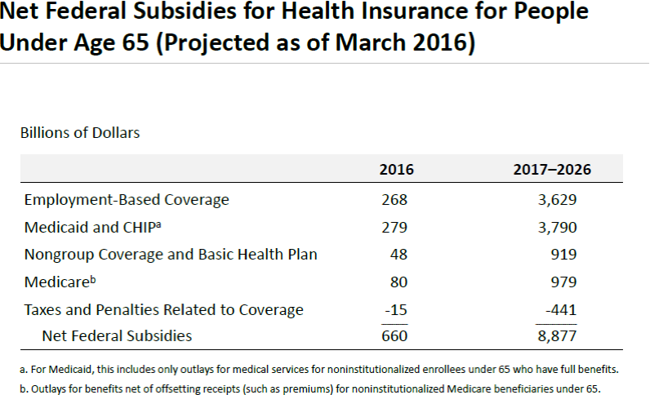
Taxpayer Funding Dominates Revenue Streams
Notes:
Employer based coverage subsidy of almost 30%.

Slide 6
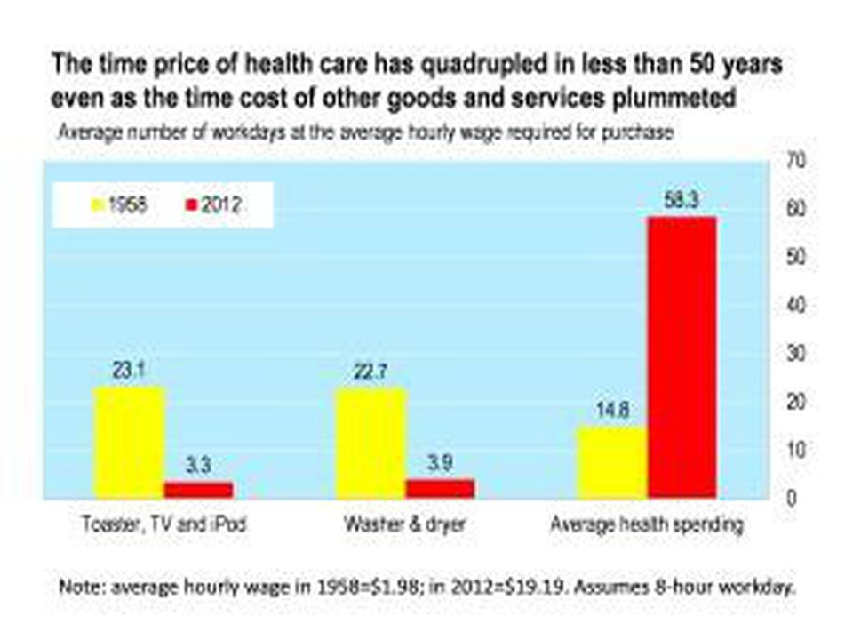
Medical Care Spending Has Outstripped Our Ability to Afford It

Slide 7
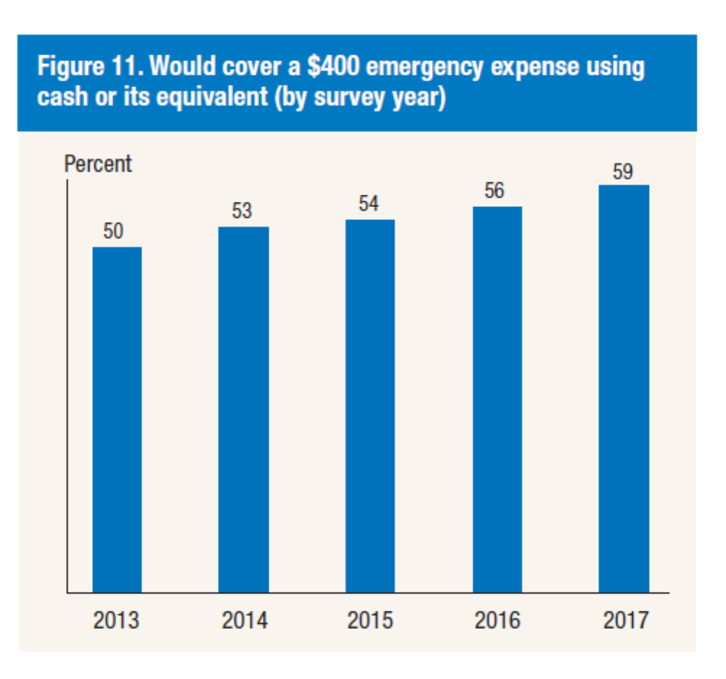
Over 40% of American Households Don’t Have the Savings to Pay Out-of-Pocket Healthcare Expenses
1 in 4 adults skipped necessary medical care in 2017 due to cost.
Among those with medical expenses, 3 in 8 have unpaid debt from the bills.
Source: Federal Reserve Board (May 2018)

Slide 8
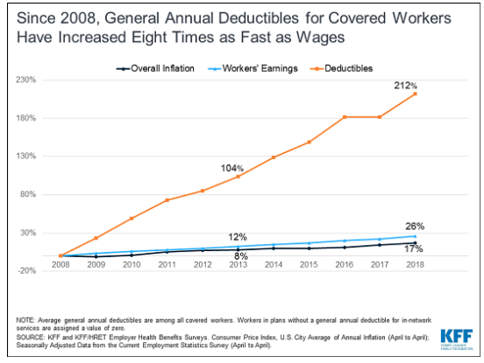
Insurance is Not Enough For Many Under 65
Notes:
People in poor or fair health, especially if they have a high deductible policy have incentives to postpone care which results in more expensive care later, much of which is paid for by others.

Slide 9
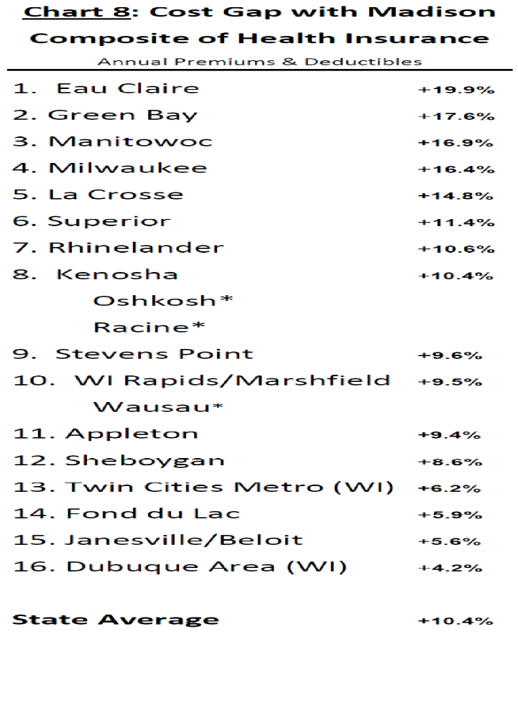
Fox Valley Medical Care is More Expensive Than In Madison or Minneapolis-St. Paul
Source: Wisconsin Health Insurance Cost Ranking Report 2018 (based on state and federal sources including Wisconsin Office of the Commissioner of Insurance)
Notes:
Physicians in Wisconsin are paid among the highest rates of compensation in the country.

Slide 10
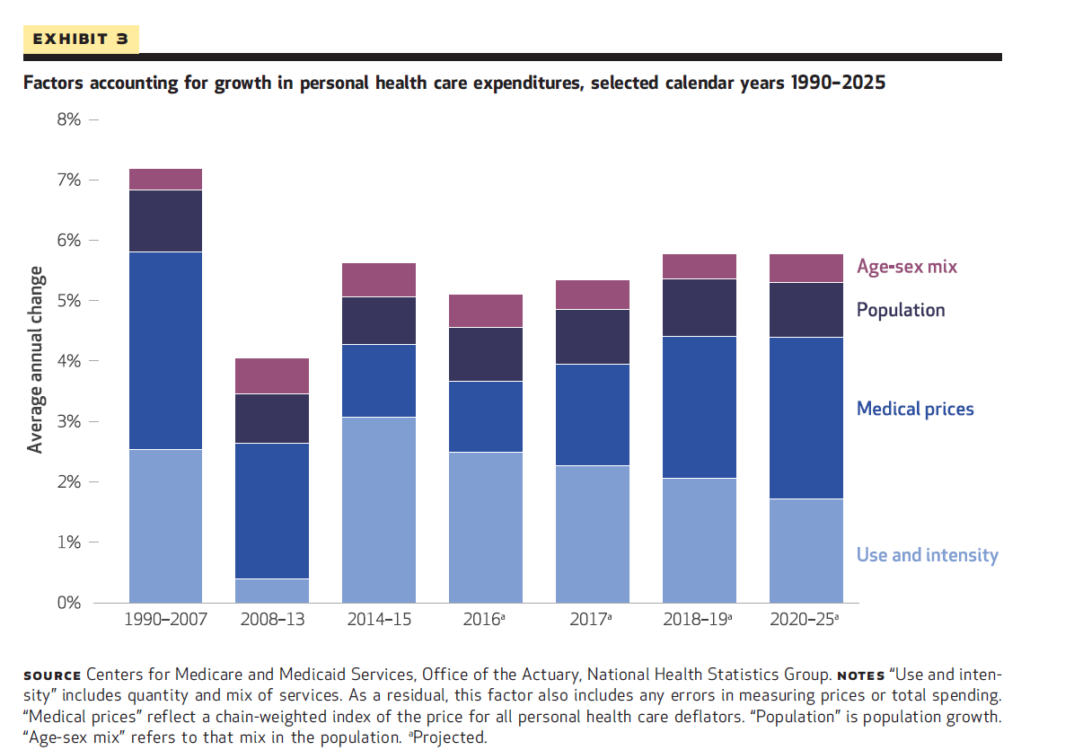
Why is Medical Care so Expensive?
Primarily high prices for services
Hospital systems have continually increased market power due mergers and acquisition and partly through restrictive contracting
Fee-for-service physician incentives yield services of limited or no value in terms of health improvement
Neither market competition nor effective regulation inhibits the market power accumulated by existing hospital systems
Notes:
Consolidation of hospital based systems has increased markedly in the past decade. The result is less market competition in many markets include the Fox Valley.

Slide 11
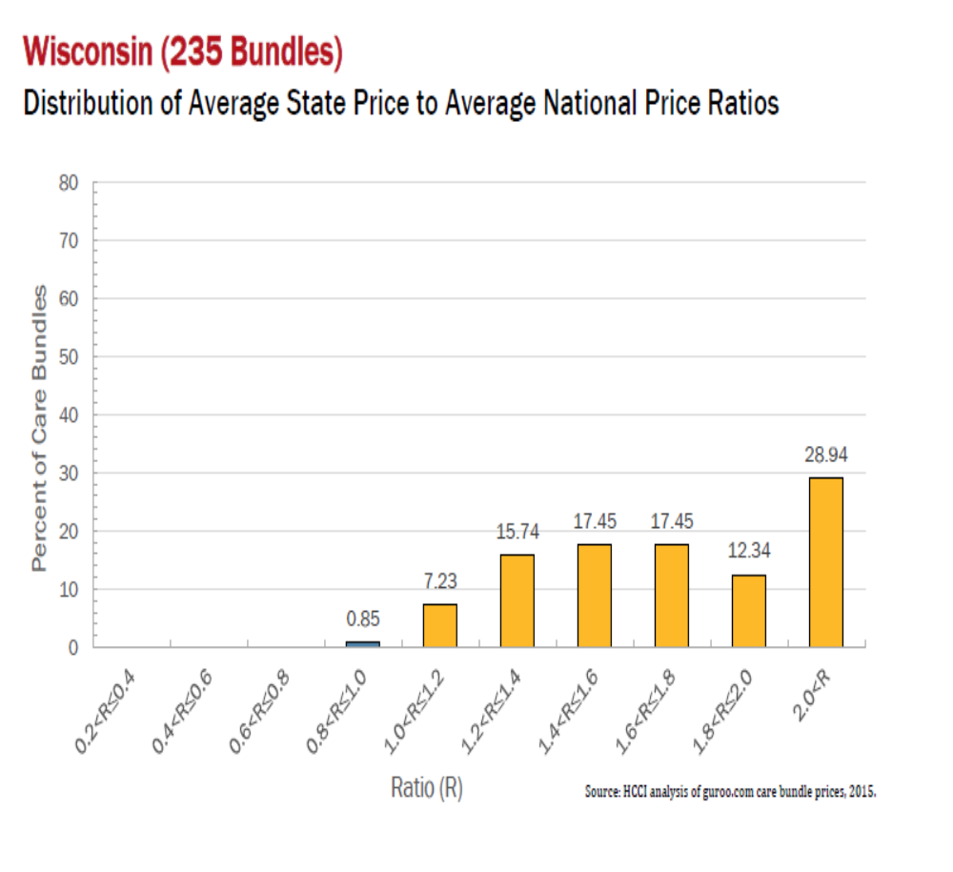
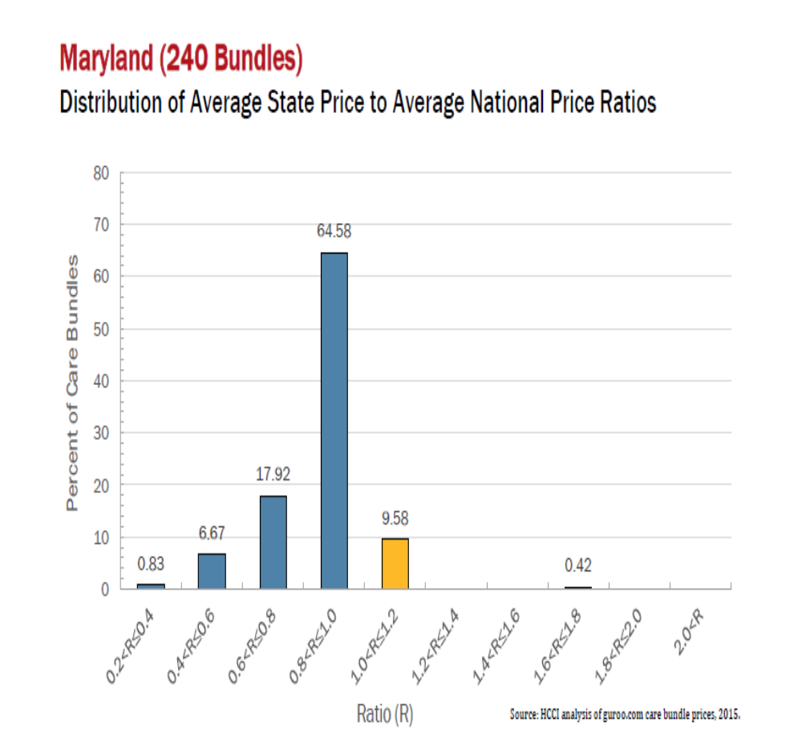
Wisconsin Ranks #3 in Medical Service Pricing
Notes:
The price of bundles of care for particular medical episodes is especially high in Wisconsin. HCCI and guroo.com

Slide 12
Higher Deductibles Are Not the Answer
Between 2010 and 2017, the percentage of privately insured people under 65 jumped from 25% to 44%.
Resulting effects:
  A short term but not long term reduction in overall health care spending.
  Most of the reduction comes from fewer services consumed – both necessary and wasteful services.
  Little consumer price shopping has resulted.
  Few people substitute lower cost services for higher cost ones.
  Low wage earners had both a much higher rate of avoidable hospital admissions & used fewer preventive services than moderate and high income earners.

Slide 13
In Our Opinion, Local Hospital Systems Are Unaccountable
Not-for-Profit (NFP) Organizations have no shareholders.
No legal constraints require their boards to act as stewards of community resources.
As is common among NFPs in medical care, executive and specialist compensation and control rises with the wealth of the organization. For example, compensation for ThedaCare’s CEO has tripled in the past decade.
The Boards of Trustees are not accountable to the communities they serve. They serve the institutions that have appointed them not the communities that gave them tax-exempt, not-for-profit status.
Hospitals are used to generate revenues for their systems; they should be thought of as cost centers with aim to minimize use.

Slide 14
What Are Not-for-Profits Required To Report?
Annual Reporting Requirements:
IRS Form 990 Form – audited financial statement, which is published with at least a two year lag.
Quarterly financial statements - filed with EMMA for all entities that have outstanding debt issues in the tax-exempt bond market.
Schedule H (990 form) describes community benefits – only required for not-for-profit hospitals, not health systems.
The Affordable Care Act increased the reporting requirements to include a statement of financial assistance policies and a community needs assessment every three years.
https://www.irs.gov/charities-non-profits/annual-reporting-and-filing

Slide 15
Community Benefit Standards Are Low and Fox Valley Hospitals are Below Average
In 2014, tax exempt hospitals spent on average 8.1% of operating expenses on net community benefits, almost all of it directly related to patient care services (> 85%) and not to the health of the community’s population (<7%) . (Young, 2018 – Health Affairs)
St. Elizabeth Hospital - Schedule H – net community benefit expenses were 5.83% of operating expenses in 2016
ThedaCare Appleton – Schedule H -net community benefit expenses were 4.23% of operating expenses in 2016
ThedaCare Neenah – Schedule H -net community benefit expenses were 6.37% of operating expenses in 2016

Slide 16
Lack of Transparency and Accountability: Ascension-Wisconsin
Members of the Board of Trustees are not listed.
No financial statements are provided.
Bylaws and conflict of interest policies are not provided.
Very limited information about pricing is accessible.
Today, as Ascension, we live our unified Mission to be rooted in the loving ministry of Jesus as healer, to serve all persons with special attention to those who are poor and vulnerable, to offer spiritually centered, holistic care that sustains and improves the health of individuals and communities, to be advocates for a compassionate and just society through our actions and our words.
http://www.affinityhealth.org/Affinity/About-Us.htm

Slide 17
Ascension-Wisconsin Has Been Unresponsive to US or to the Local Community
Asked for list of members of the Board of Trustees – reluctantly provided.
Asked for 2016 IRS 990 Form – provided only when we indicated non-compliance w/ IRS regulations.
Asked about role of Fox Valley based Board of Trustees – learned that financial decisions are made in Milwaukee or St. Louis, depending upon the amount.
Learned from Journal Sentinel article that funds from operations in the Fox Valley diverted to Milwaukee.
Learned from Journal Sentinel that Ascension plans to spend $100 million on facilities near the Fox Conn plant in SE Wisconsin
Ascension is still spending money on its campaign to create a national brand in contrast with efforts to improve the health of the communities they serve.

Slide 18
Lack of Transparency and Accountability:
ThedaCare
ThedaCare provides a list of the members on its board of trustees.
Neither bylaws nor conflict of interest policy are available on website.
Financial statements are not made available; Community benefit expenses (net amount based on 2016 - 990 Forms for 2 hospitals) average 5% of operating expenses.
Mission: Improve the health of the communities that we serve
Claim: “As a community owned, non-profit, charitable organization, ThedaCare belongs to the community.” Does it?
www.thedacare.org

Slide 19
Does ThedaCare Work for This Community?
TC provided conflict of interest policy after our only meeting with two representatives.
They refused to provide a copy of their bylaws.
We attempted to meet with members of the Board and were told (by two of them) that any communication with TC must go through TC’s President.
CEO/President Andrabi has not responded to our request for a meeting. In the Appleton Post-Crescent, he stressed the importance of communication in order to “listen, discuss and understand.” REALLY?
Why does TC have almost $100 million of investments in offshore activities?
“I was a patient of Dr. Guenther for 20 years. My Rituximab cancer treatments from FVHO were never more than $10,400.00. After Medicare and insurance my out of pocket cost was $279.99. My Rituximab treatment after ThedaCare took over was $21,892.85. My out of pocket costs went up to $908.24.” – GG from Waupaca
In 2016, five members of TC were paid in excess of $1 million.

Slide 20
Reform Ideas
Make the Boards of Trustees accountable to the community rather than just the organization that selects them.
Establish a public sector purchasing cooperative with sufficient volume of potential patients to redirect funding towards the health of the Fox Valley population not out of the community or towards the takeover of competitors.
Change the character of our medical care systems and the perverse incentives of fee-for-service payment to incentives that encourage integrated health cooperatives with responsibility to be good stewards of community resources.
https://www.wearthecost.org –the Maryland story
https://khn.org/multimedia/get-a-rise-out/

Slide 21
ThedaCare Board of Trustees
Who Do These People Represent?
Imran Andrabi, MD (President)
ThedaCare
Tim Bergstrom
Bergstrom Automotive
Patrick Brennan, MD
Surgical Associates of Neenah
Mark Burstein
Lawrence University
John Davis (Past Chair)
Great Northern Corporation
Gary Edelman, MD
ThedaCare Physicians
David Koeper, MD
Fox Valley Nephrology Partners
Jim Kotek (Vice-Chair & Secretary)
Menasha Corporation
Grant LaMontagne
Kimberly-Clark
Jim Meyer
BMO Harris
Doug Moard, MD
ThedaCare Physicians
Karen Timberlake
Michael Best Strategies
Terry Timm (Chair)
Thrivent
Norma Turk, MD
ThedaCare Regional Medical Center-Appleton
Maria Van Laanen
Fox cities Performing arts Center
Cyril Walsh, MD
ThedaCare Regional Medical Center-Appleton
Notes:
What input does the community have in decision-making such as buying up a competitor (FVHO)? The Board needs to be changed. Perhaps they should be elected as they are at GHC of SWW.

Slide 22
Public Sector Purchasing Cooperative in the Fox Valley
We propose to have the major public sector entities in the Fox Valley join together into a purchasing cooperative that offers two choices to its health plan enrollees: Value + Choice
Value involves enrolling in a primary care based system that contracts for specialty and hospital services. The health plan features low, if any, deductibles and co-pays.
Choice enables eligible enrollees to select a traditional plan with a larger network of medical care providers and features higher premiums and significant deductibles, co-pays, and co-insurance.

Slide 23
Purchasing Cooperative (continued)
The public sector entity would pay most if not all the premium cost of the Value plan. Those who select the Choice plan receive the same dollar support as those who choose the Value plan but must cover all remaining costs on their own.
To generate enough enrollees, membership would be open to individuals, employees of non-profits, and employees of small businesses.
Objective: build a purchasing cooperative with at least 10% of the non-Medicare, non-Medicaid population in the Fox Valley. From an estimated population of 300,000 for the three county area → 30,000 covered lives.
Viability: 5,000 to 10,000 covered lives needed to establish a primary care based system.

Slide 24
Why Establish a Public Sector Purchasing Cooperative?
Public sector officials should represent the residents of their jurisdiction since those residents pay their salaries and many residents cannot afford to purchase equivalent health plans or medical care.
Public sector organizations can not move operations to Mexico or China.
These jurisdictions continue to face increasing medical care costs and increased deductibles or employees’ share of premiums will not make medical care more effective or affordable.

Slide 25
Tepid Response From the Leadership of Fox Valley Public Sector Organizations
We have met with the mayors of Appleton and Neenah, the CAOs of Calumet, Outagamie and Winnebago Counties, members of the Outagamie County Board of Supervisors and others from not-for-profit organizations.
We asked them to convene a meeting for us to explain public sector purchasing cooperatives.
Several agreed to make calls on our behalf but no followed through at this point.
Notes:
Who do they serve?

Slide 26
Not-for-Profit Integrated Health Care Organizations
Many health care organizations operate their own insurance companies & are recognized nationally for the quality of the care they provide.
Group Health Cooperative of South Central Wisconsin (NCQA – 5)
Group Health Cooperative of Puget Sound- now in KPMCP (NCQA – 4.5)
Health Partners (Cooperative) – Minneapolis, MN (NCQA – 4.5)
Dean Health Plan (Wisconsin) 4.5
NCQA ratings based on consumer satisfaction, prevention, and treatment. https://www.ncqa.org/report-cards/health-plans/state-of-health-care-quality-report/

Slide 27
Opinions Based on Evidence Provided
Medical care in the Fox Valley is too expensive and does not affordably address the needs of many Fox Valley residents.
Neither regulation nor competition constrains the two primary local medical care systems (Ascension and ThedaCare.)
The result is an elite group of hospital executives and physicians who extract more and more resources from us.
Both systems lack both accountability and transparency.
  Decision-making either exists outside the area and even outside the state (Ascension) or
  Reflects the organization’s interests at the expense of competition in medical care markets (ThedaCare.)
Numerous reform options exist. All require changing how we pay for & allocate funds we as a community devote to sustaining & improving the health of our residents.

Slide 28
The Future and Your Role
With no serious reform, expect more of the same or worse. My 39+ years in Appleton shows diminished competition and increased cost.
Medicare and Social Security feature unfunded liabilities exceeding $45 trillion. See http://usdebtclock.org.
To change decision-making requires putting pressure on local public officials – elected or not – to change how they purchase care.
Employer sponsored insurance absorbs what Medicare and Medicaid don’t pay. Most of this comes out of worker compensation.
To paraphrase Marathon County Chief Executive Brad Karger: Purchase better health for employees and county residents not just discounted (and higher priced) medical care.

Slide 29
How Would Effective Regulation or Market Competition Change Fox Valley Health Care?
Bill McLaughlin served the Wisconsin Hospital Rate Review Program.
How could effective regulation matter?
David Riemer helped design the State Employee Health Insurance Purchasing Program.
How could serious market competition be introduced into Fox Valley health care markets?

Slide 30
We Need Your Help! Doing Nothing Means More of the Same.
Students: Learn about the burdens you will face; question elected officials about what they will do to effect change.
The employed: Ask your human resource and finance officers to press for serious change.
Those who vote: Ask your elected representatives (especially local public officials) why those who pay taxes to support their programs struggle to afford their own medical care.
Those on Medicare: You are the beneficiaries of our current largesse. Help your children and grandchildren by advocating for sustainable reform.
Those on Medicaid: Many of you have richer benefits than those with modestly higher incomes. Your benefits are not sustainable. Be advocates for sustainable reform.

Slide 31
Effective Reform
Requires a relatively small group of people who won’t settle for the status quo. They won’t take “NO” for an answer.
Can be done despite the political barriers. Changes to tobacco laws and car safety were not initiated by elected officials or large, well entrenched businesses.
Should press for solving quality and affordability problems and not be constrained by policies pushed by particular interest groups.
www.foxvalleyhealthcare.com
https://noconecon.blog/

Slide 32

It’s Your Turn
We welcome your thoughts and questions.

